Slide 1



Enrollment Visualization
View in Power BI
View in Power BI
Last data refresh:
5/6/2022 3:26:07 AM UTC
Downloaded at:
5/6/2022 3:30:03 AM UTC

Slide 2
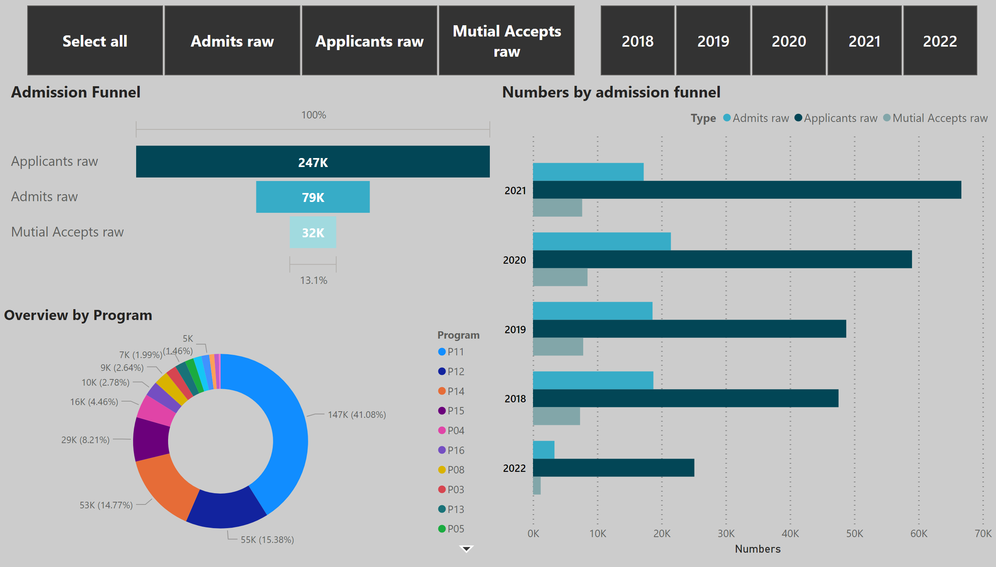
Page 1
Notes:
slicer
No alt text provided
slicer
No alt text provided
Overview by Program
No alt text provided
Numbers by admission funnel
No alt text provided
Admission Funnel
No alt text provided

Slide 3
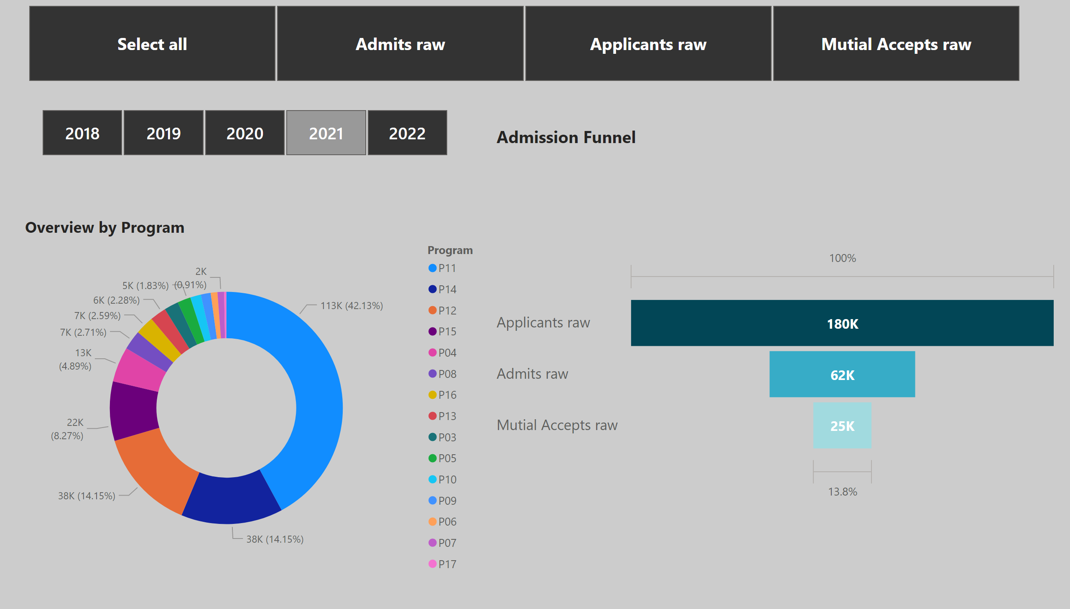
Overview
Notes:
slicer
No alt text provided
slicer
No alt text provided
Overview by Program
No alt text provided
Admission Funnel
No alt text provided

Slide 4
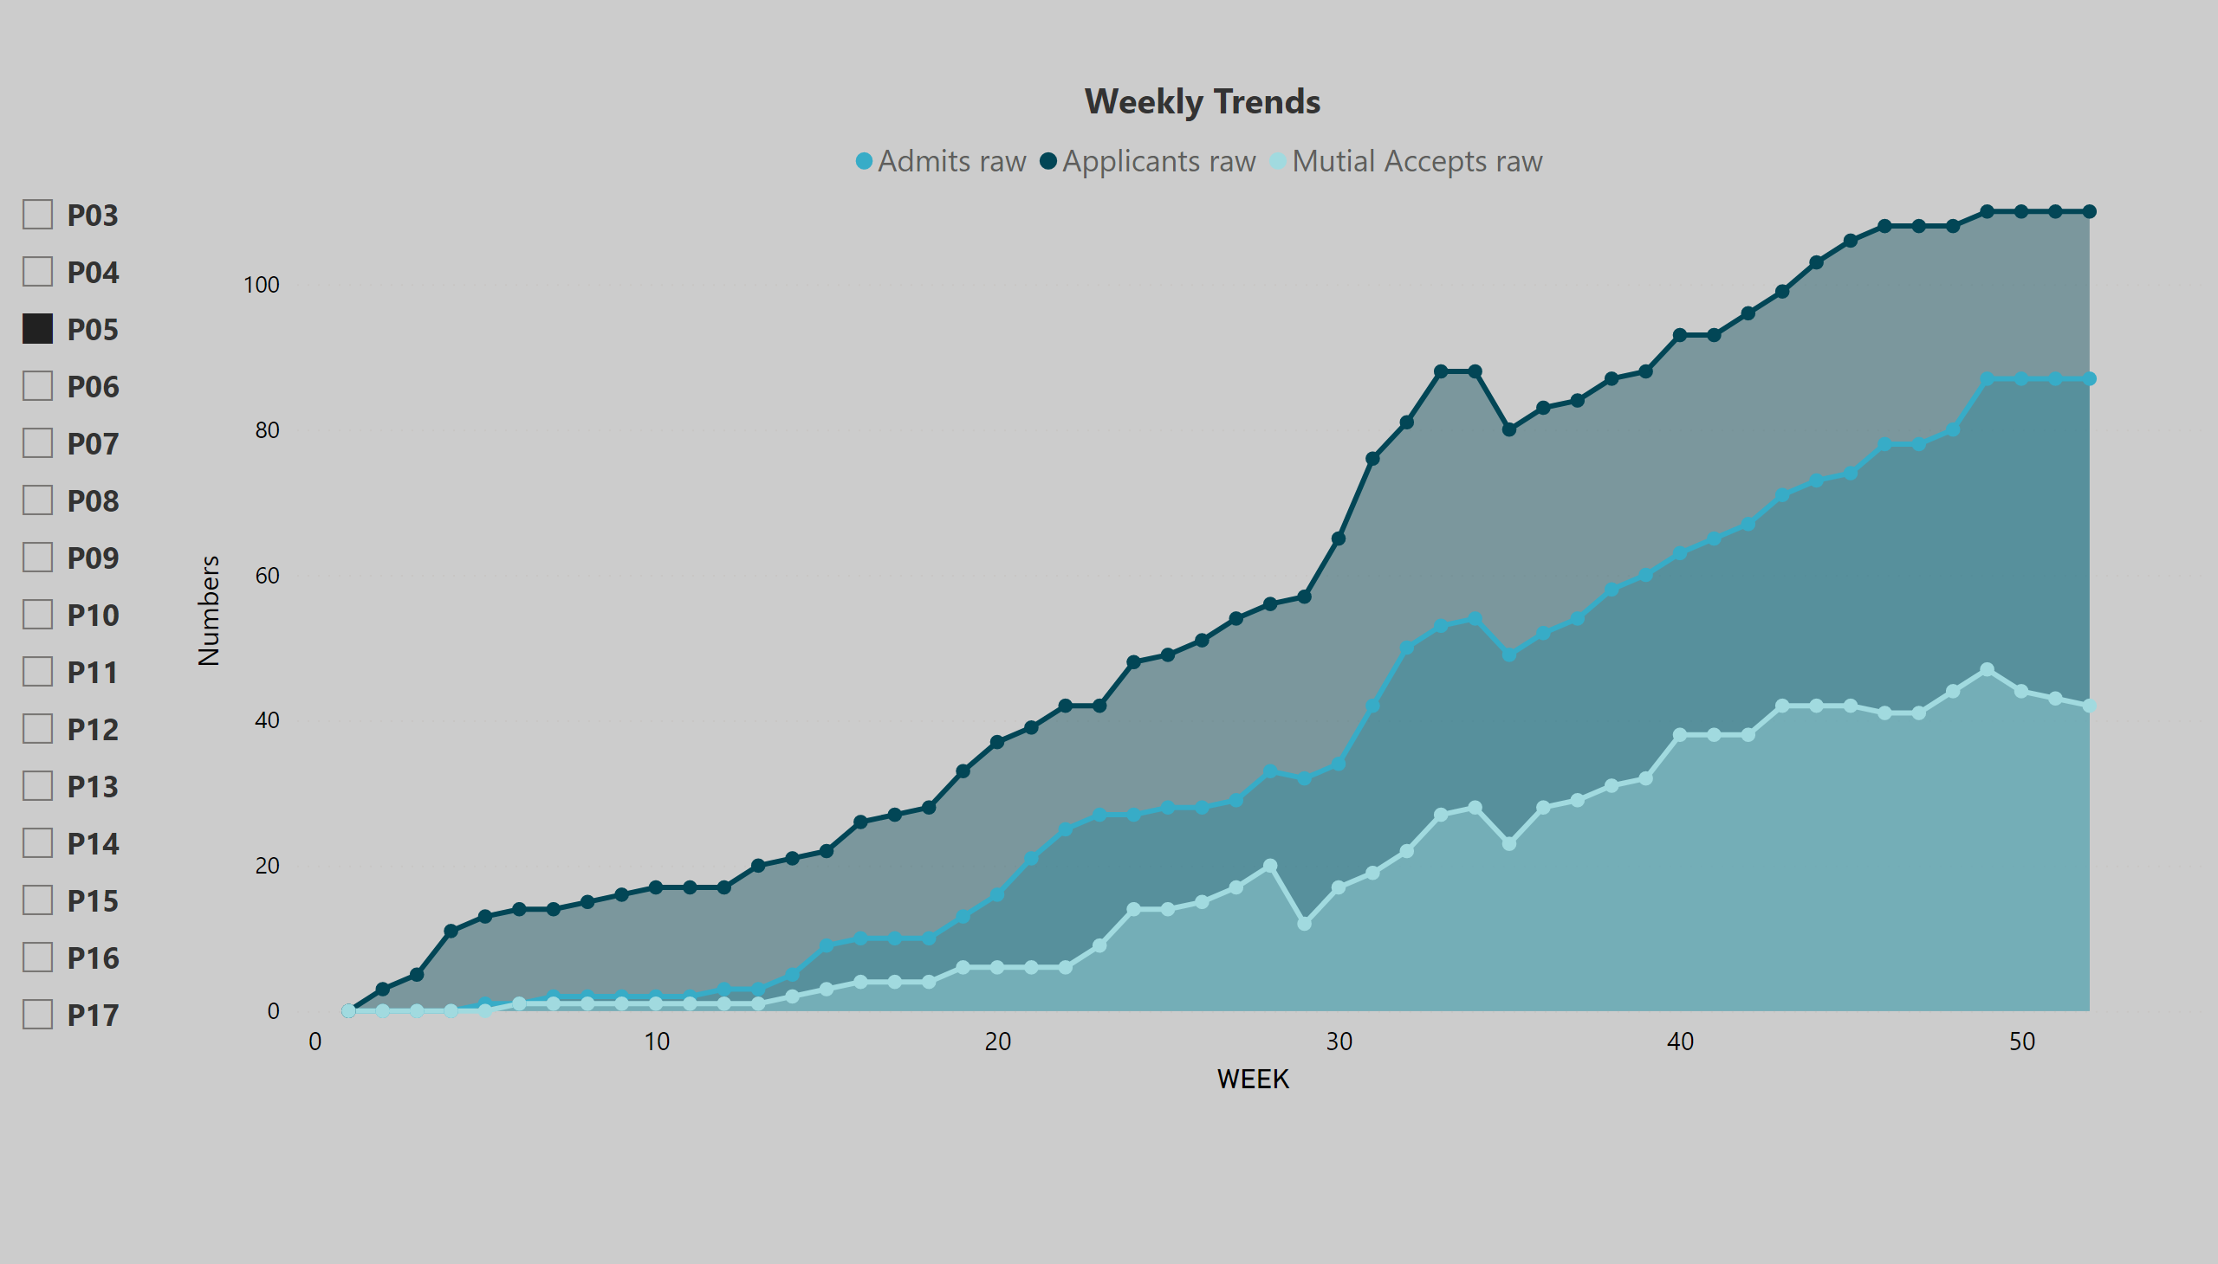
Page 2
Notes:
slicer
No alt text provided
Weekly Trends
No alt text provided

Slide 5
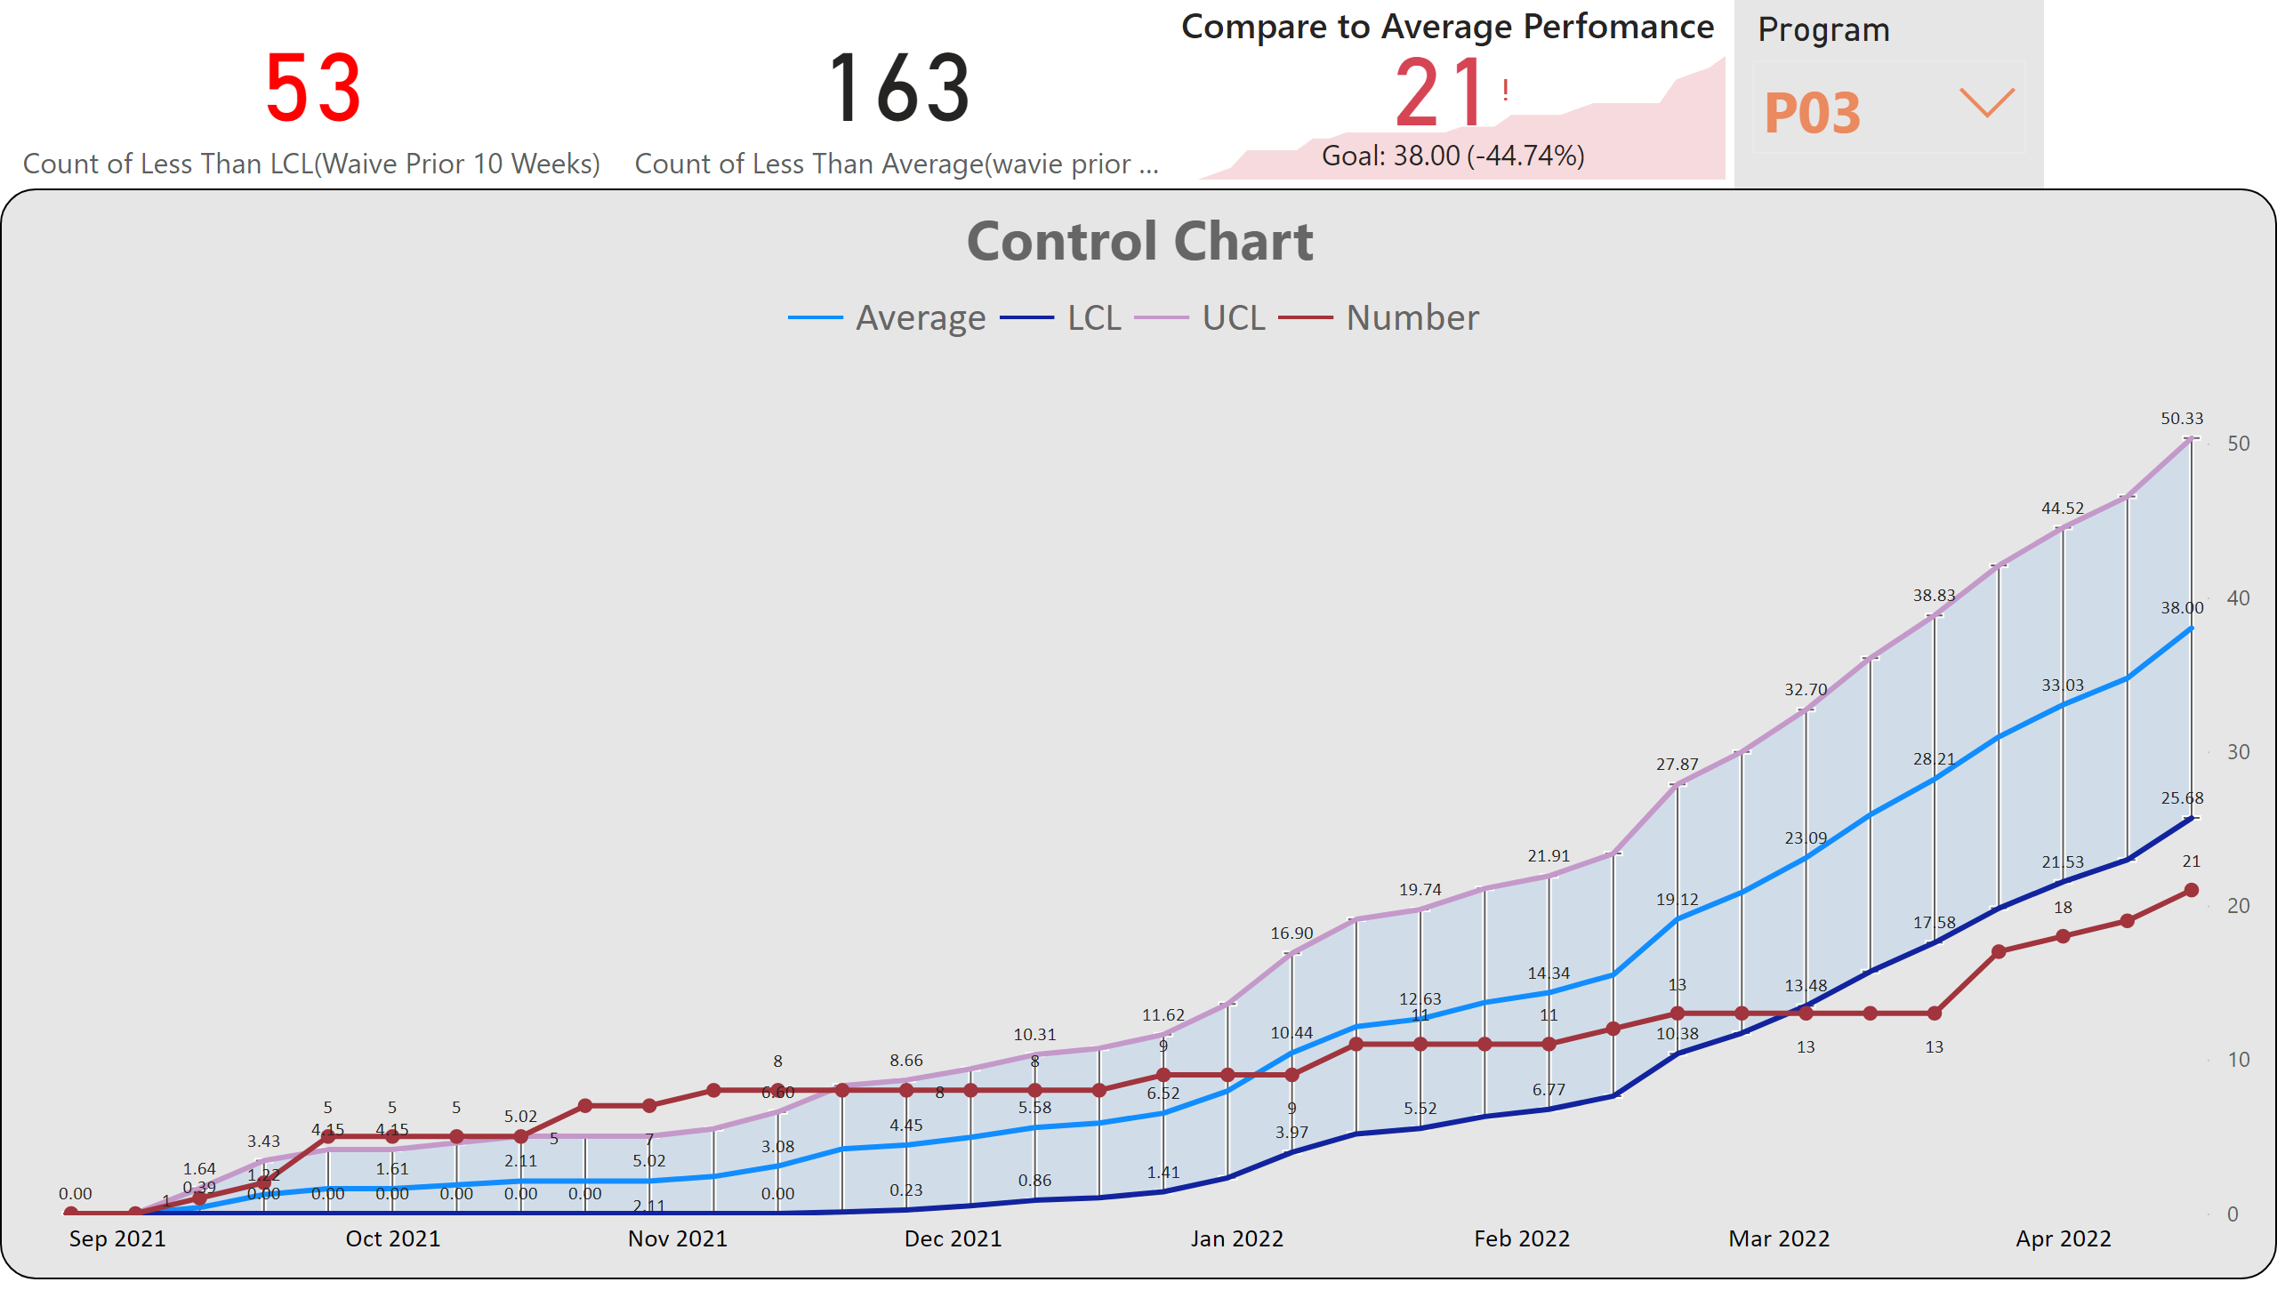
第 1 页
Notes:
Control Chart
No alt text provided
slicer
No alt text provided
card
No alt text provided
Compare to Average Perfomance
No alt text provided
card
No alt text provided

